Slide 1
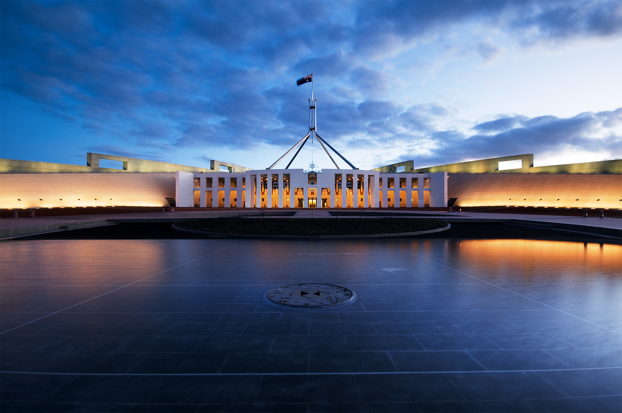
Year 11: Politics & Law

Slide 2
SYLLABUS DOT POINTs 2 + 3 (examinable material)
Structure of the Australian political system and the Australian legal system, including:
Separation of powers
Division of power
Representative government (previous slides)
Westminster conventions of responsible parliamentary government (previous slides)
Constitutional monarchy (previous slides)
Common law system (done later)
Roles of the legislative, executive and judicial branches of government (Separation of Powers)

Slide 3
Outline
The Structure of Australian Federal Parliament
Head of State
Head of Government
Bicameral Parliament
The Separation of Powers

Slide 4
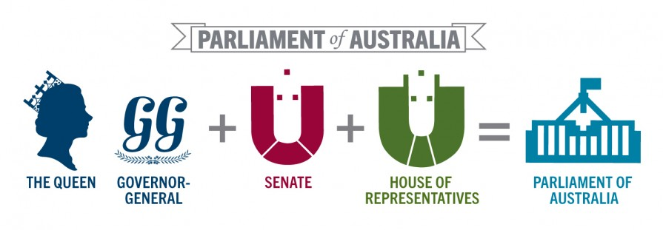

Slide 5
Head of State
Title:
The King/king
The Governor-General is the king’s representative in Australia
Appointment:
GG is appointed by the king on the advice of the PM
The appointment is ‘at the king’s pleasure’ and is usually for five years, although the term can be extended or shortened, again on the advice of the Prime Minister

Slide 6
Head of State
Removal:
The monarch is a hereditary position within the British royal family. The monarch cannot be removed, though he or she may abdicate as Edward VIII did in 1936
The GG may be removed by the king on the advice of the PM
No Australian GG has ever been dismiss
Reform:
In recent times there have been calls for an Australian head of state rather than a monarch
A referendum to change the Australian Constitution to make Australia a republic (and therefore to change our head of state) was defeated in 1999.

Slide 7
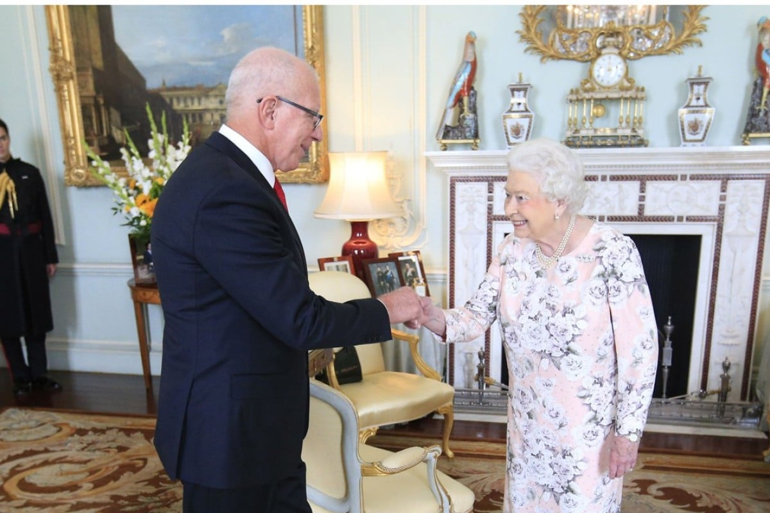

Slide 8
Head of Government
The Prime Minister is the head of government.
He or she achieves this position by being the elected leader of the party in government
By convention, the PM is a member of the House of Reps who leads the parliamentary party, with the support of the majority of members in the House
Australia has no maximum period of service for PM, unlike countries such as the US (two four-year terms)

Slide 9
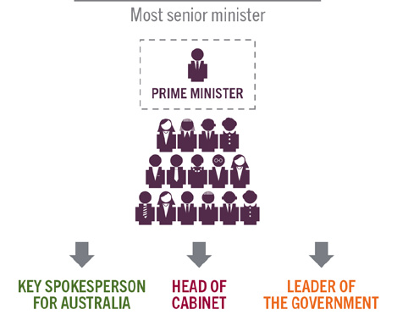
Role of the Prime Minister

Slide 10
Limiting Government
Principle of good government
Prior to 1700s: traditional idea = the king had absolute power to make decisions for his people; only answerable to God; ruled by Divine right
By 1700s, political thinkers such as Rousseau, Locke and Montesquieu claimed that the powers of government should be limited, divided and checked
Separation of powers = one of the key ideas that opposed arbitrary rule by absolute monarchs

Slide 11
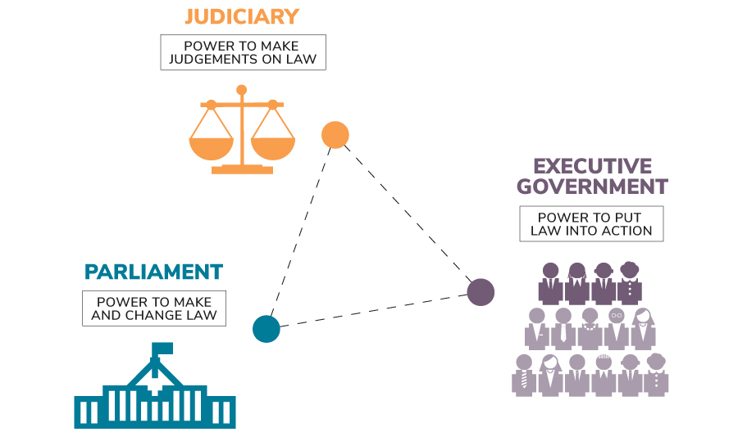
Separation of Powers (3 branches of Gov)

Slide 12
Separation of Powers
Definition:
“ The division of government executive, legislative and judicial powers into separate arms or institutions that act separately and are independent of each other. The separation of powers was advocated by the French political thinker, Baron d’Montesquieu, as way of ensuring that governments could not wield excessive power. The separate arms of government provide a system of checks and balances on each other. The most important feature of the separation of powers is the independence of the judiciary”.

Slide 13
Applying the Separation of Powers
Note: There has never been a clear separation of legislative and executive power in modern democracies
The concept has been adopted in different ways by different modern governments
The most important idea highlighted by the separation of powers is the independence of the judiciary = this concept is central to the principles of good government
Courts should base their decisions on the authority of law, not on opinion
They must be free of interference from legislators or executive leaders
Whatever the relationship between the legislative and the executive, neither body should have any authority over the judiciary
Notes:
US:
Legislative = Congress
Executive power = The President
Judicial power = Supreme Court

Slide 14
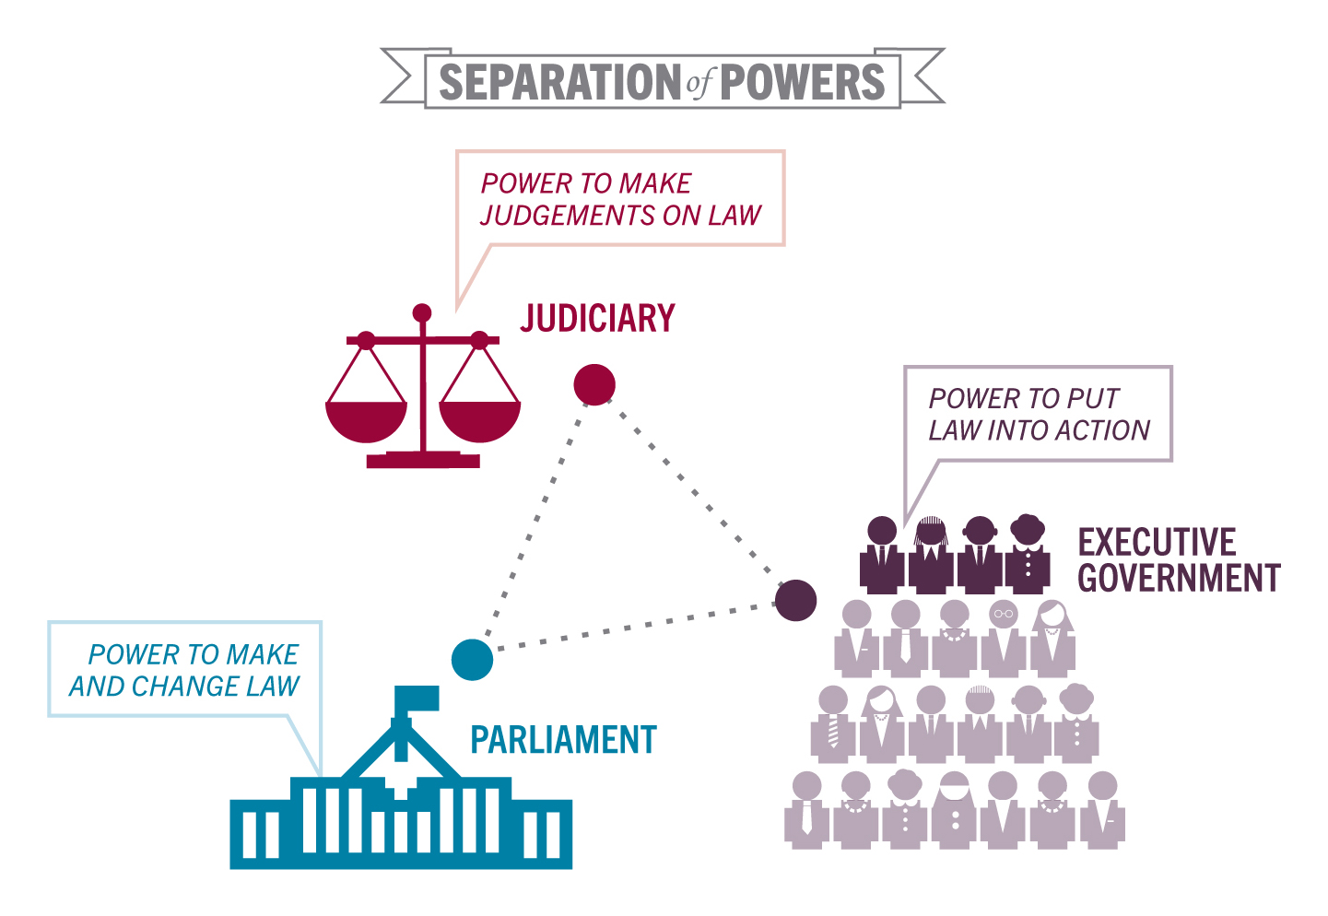

Slide 15
Separation of Powers
The Australian Constitution is the set of rules by which Australia is run
The Constitution describes the legislative, executive and judicial arms of Australian governance (first 3 chapters)
Australia has a limited separation of powers. The Executive is drawn from the legislature or Parliament. Members of the Judiciary (High Court judges) are appointed by the Governor-General, on the advice of the Executive

Slide 16
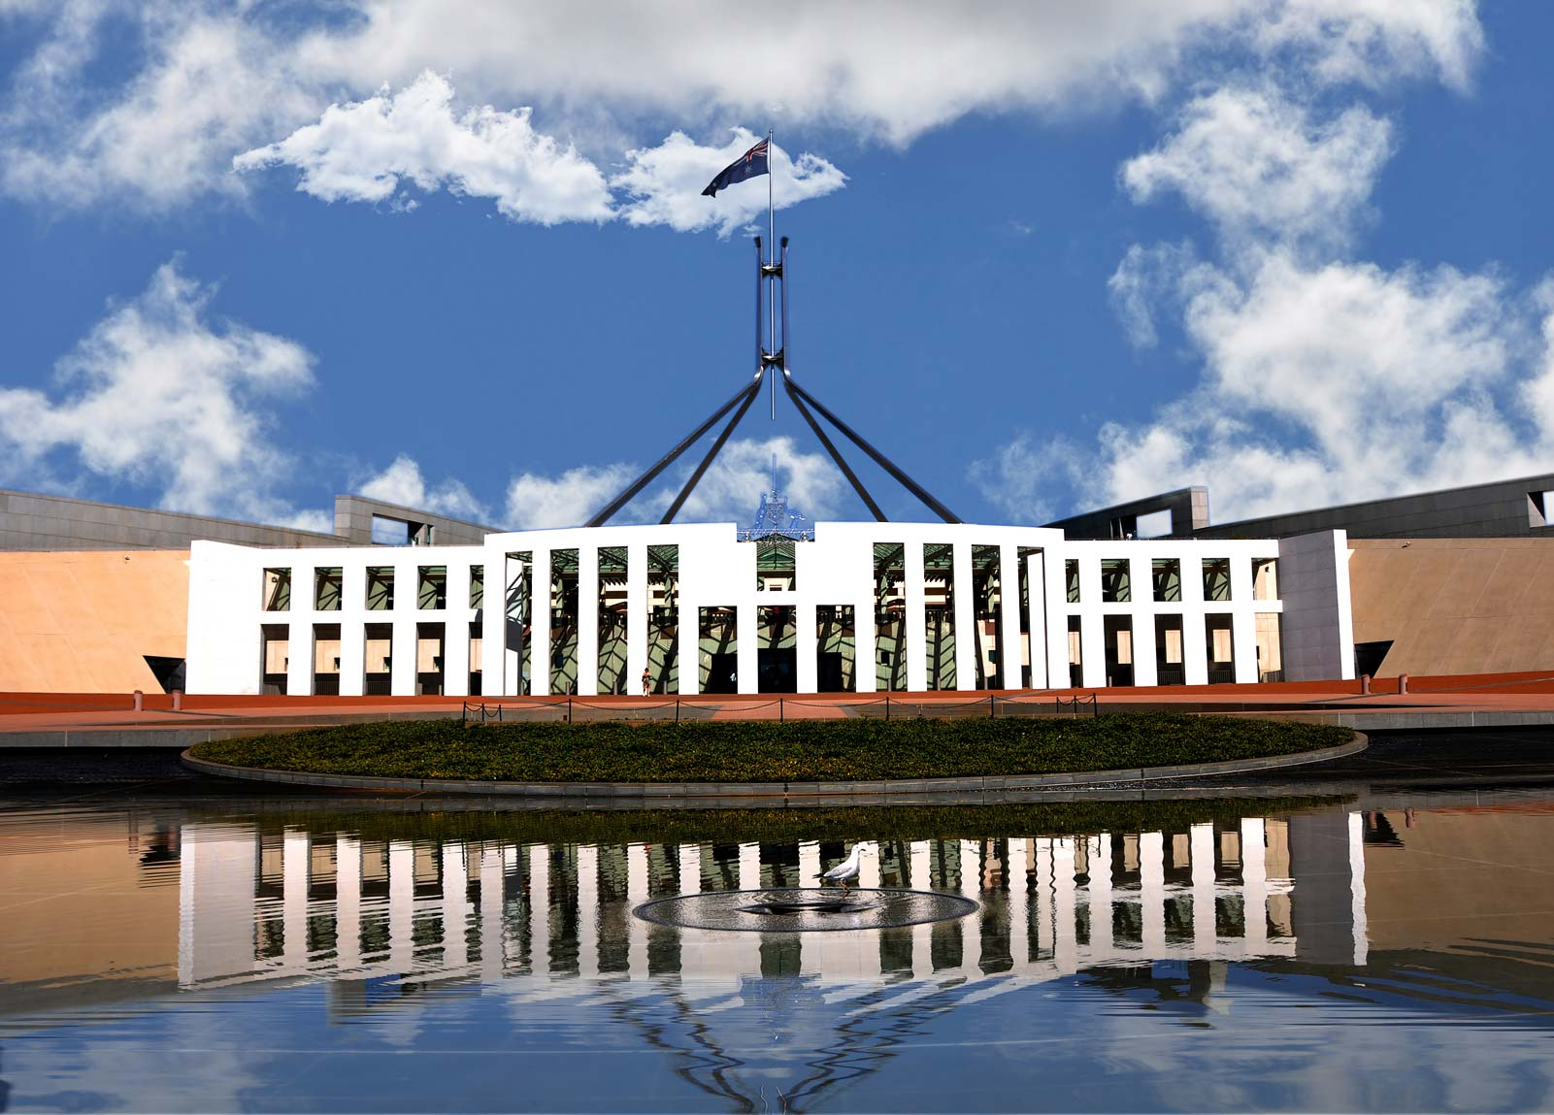
The Legislative Branch

Slide 17
Operation of the Legislature
The Australian Parliament is bicameral, meaning it consists of a House of Reps and a Senate.
Composition
The House of Reps has 151 members. Each member represents an electorate (single member electorates)
The Senate has 76 senators. Each state is represented by 12 senators and each territory is represented by two senators (multi member electorates)

Slide 18
Operation of the Legislature
AUS government is formed in the House of Reps = the party with the support of the majority in the House
House of Reps:
Preferential voting
Term = maximum of 3 years (usually before)
Senate:
Proportional representation = allows for minorities
Senators normally serve fixed six-year terms (from 1 July to 30 June), unless the Senate is dissolved earlier in a double dissolution.
The term of the territory senators expires at the same time as there is an election for the House of Reps
There is no constitutional requirement for the election of senators to take place at the same time as those for members of the House of Reps, though the government usually synchronizes election dates
Note: Double dissolution = both houses are dissolved

Slide 19
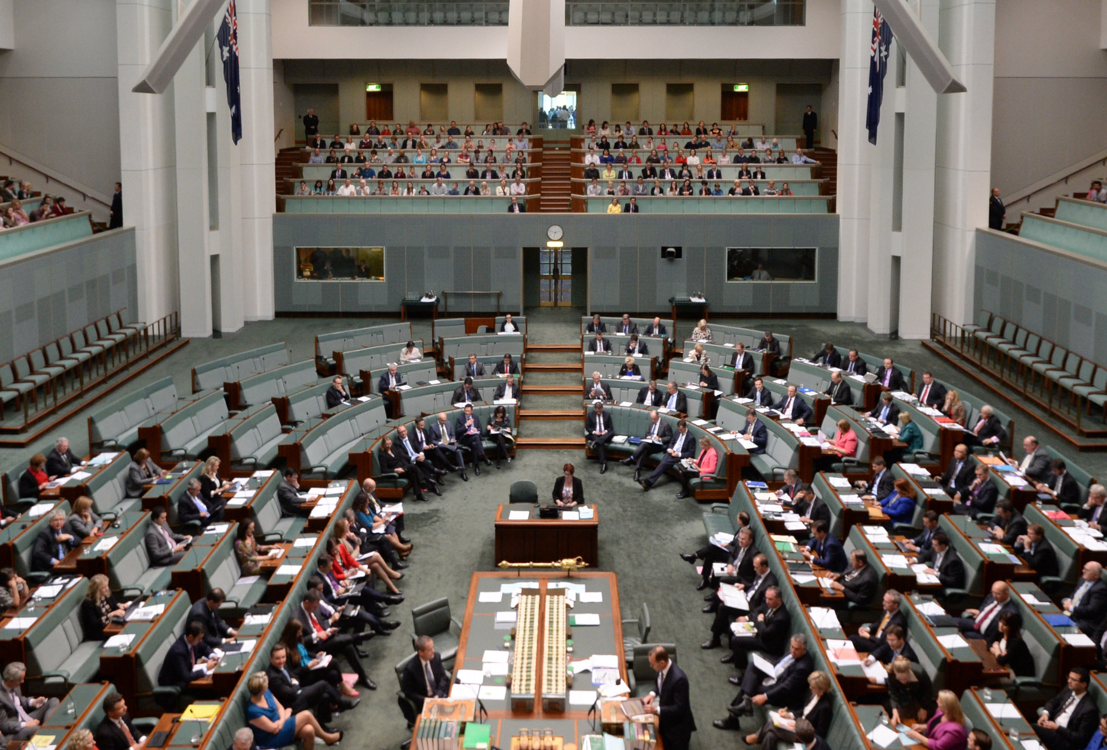
Notes:
Lower House = House of Representatives
Prime Minister & cabinet sit

Slide 20
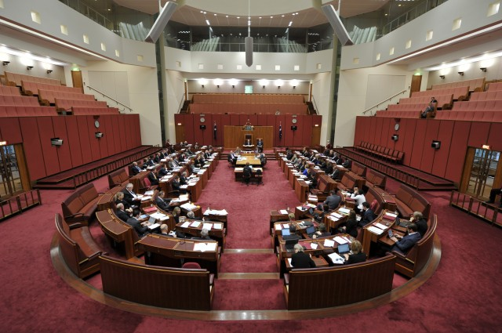
Notes:
Bicameral Parliament = two houses
Upper house: Senate

Slide 21
Operation of the Legislature
Bills
Parliament has Parliamentary Sovereignty (overarching ability to make laws – delegated by the people)
A bill (proposed law) must pass through each of the two houses in identical form before it becomes law
Legislation is usually introduced by a minster in either house. The majority of bills are ‘government bills’
A small number of bills (‘Private Member Bills’) are introduced by other members of parliament, although few become law. Why is this the case?

Slide 22
Operation of the Legislature
Committees
Members of parliament may refer bills to committees for further scrutiny and recommendations
Both house use committees to investigate bills and other issues in more detail than is possible in the chamber. In practice, it is usually Senate committees that look into bills

Slide 23
Operation of the Legislature
Assent
When a bill has passed the Parliament, it is presented to the GG for signing into law. This final step in the process of establishing an Act of Parliament, or law, is known as ‘Royal Assent’ (section 58)
The GG, on the advice of the government, may request that the Parliament amend (change) a bill, but this is rare

Slide 24
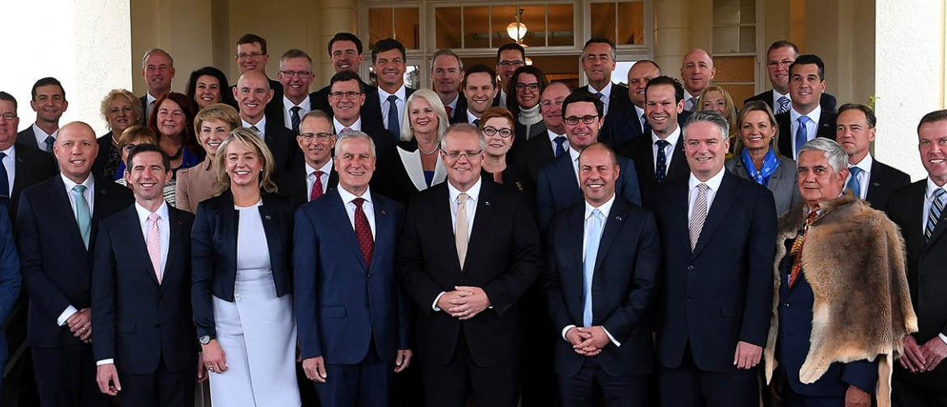
The Executive Branch

Slide 25
Role of the Executive
Composition
Executive government consists of the Prime Minister and ministers
The PM and high-ranking ministers meet in Cabinet. The deliberations of Cabinet are confidential
Each minister is an elected member of parliament as well as being responsible for the management of their department

Slide 26
Role of the Executive
Appointment
The PM is the leader of the party or coalition (partnership of parties) who forms the government, and has been chosen as leader by a vote of the parliamentary members of this party
The PM normally selects ministers who are then commissioned by the GG (section 64)

Slide 27
Role of the Executive
Responsibility
The executive is responsible to the Parliament and each minister must answer to the Parliament for the operation of their department and the laws they introduce and administer
The executive can be scrutinized in both the House of Reps and Senate particularly in Question Time

Slide 28
Role of the Executive
Size
Executive government, which is also known as the ministry, can be made up of no more than thirty ministers (plus 12 Assistant Ministers)
High-ranking ministers who are in charge of major departments form the Cabinet
Junior ministers are not members of Cabinet though they do attend Cabinet meetings from time to time

Slide 29
Role of the Executive
Removal
There is no limit to the number of terms a PM can serve. The PM may be replaced if members of the government elect a new leader or if the government loses the support of the majority of members in the House of Reps
Ministers lose their appointment if the GG withdraws their commission. This can occur on the advice of the PM or if the minister vacates their seat in Parliament or fails to retain it in a federal election

Slide 30
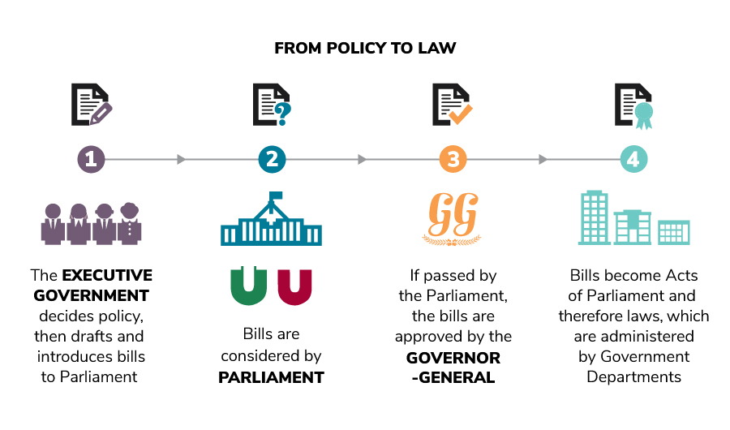

Slide 31
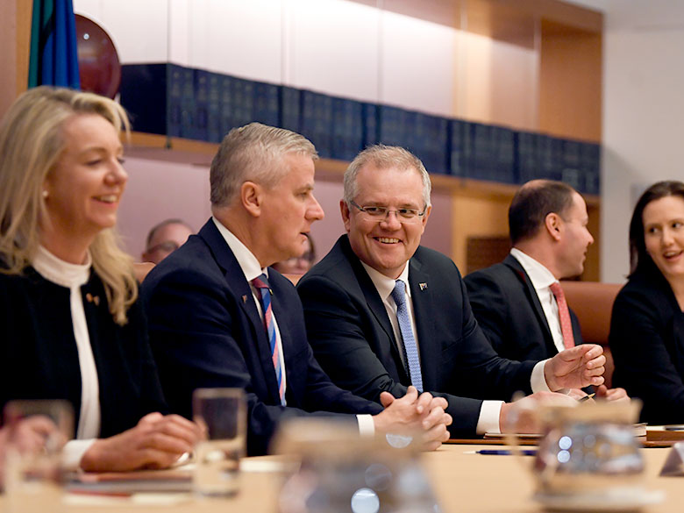
Notes:
The Cabinet

Slide 32
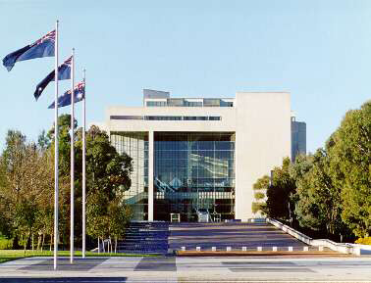
The Judiciary
Notes:
High Court of Australia
Appellate and original jurisdiction
Interprets the Constitution

Slide 33
Role of the Judiciary
The Judiciary makes judgments about the law
The Judiciary is made up of the High Court and other federal courts
Federal Court of Australia
Family Court of Australia
Federal Circuit Court of Australia
Notes:
The Federal Circuit Court of Australia – formerly known as the Federal Magistrates Court of Australia
It hears matters broadly relating to family law and child support, administrative law, admiralty law, bankruptcy, copyright, human rights, industrial law, migration, privacy and trade practices. There has been a shift recently towards having most cases held in this court, thereby freeing up workload so the Federal Court of Australia and the Family Court of Australia can hear more complicated cases. This court also hears appeals from various federal tribunals

Slide 34
Role of the Judiciary
The High Court has 2 major roles/powers:
Original Jurisdiction
Hears matters on the Constitution (the only court in Australia with this power)
Section 75 and 76
Appellate Jurisdiction
Hears appeals from lower courts
Section 73

Slide 35
Summary
Legislature
The Parliament makes and amends the law
Parliament is made up of the king (GG), the Senate and the House of Reps
Executive
The Executive puts the law into action
The Executive is made up of the king (GG), the PM and ministers
Judiciary
The Judiciary makes judgments about the law
The Judiciary is made up of the High Court and other federal courts

Slide 36
Checks and Balances
There are several ways that each branch can ‘check’ the power of other branches
See the diagram on page 14 and write down 1 check each branch has on another
i.e. The High Court (judicial branch) has the power to dismiss a law (legislative branch)

Slide 37

Consolidate Learning…
Class discussion question:
Do you think our separation of powers is fair and just?
What is the extent of our separation of power?

Slide 38
SYLLABUS DOT POINTs 2 + 3 (examinable material)
Structure of the Australian political system and the Australian legal system, including:
Separation of powers
Division of power
Representative government (previous slides)
Westminster conventions of responsible parliamentary government (previous slides)
Constitutional monarchy (previous slides)
Common law system (done later)
Roles of the legislative, executive and judicial branches of government (Separation of Powers)

